Slide 1
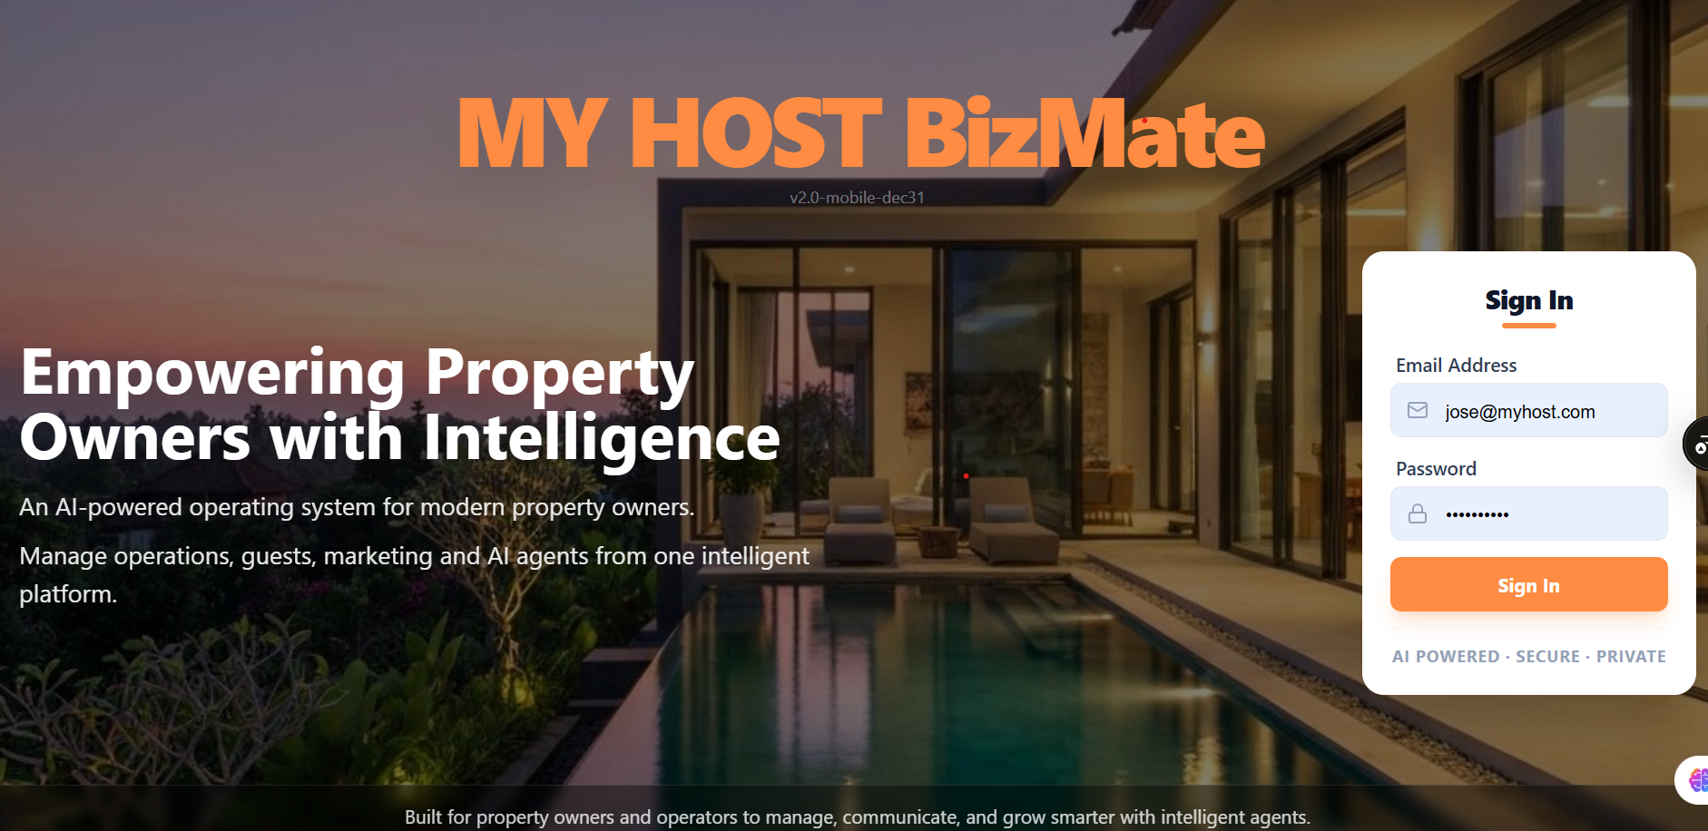
IZUMI Hotel Edition

Slide 2




What is MY HOST BizMate?
MY HOST BizMate is an all-in-one AI platform designed specifically for boutique hotels and villas, streamlining operations and enhancing guest experiences.
Sell more bookings
Communicate automatically with guests
Boost your sales and convert more inquiries into confirmed stays with intelligent automation.
Manage seamless, automated guest interactions 24 hours a day, improving satisfaction.
Control operations from one dashboard
Oversee and manage all facets of your business efficiently from a single, intuitive dashboard.

Slide 3
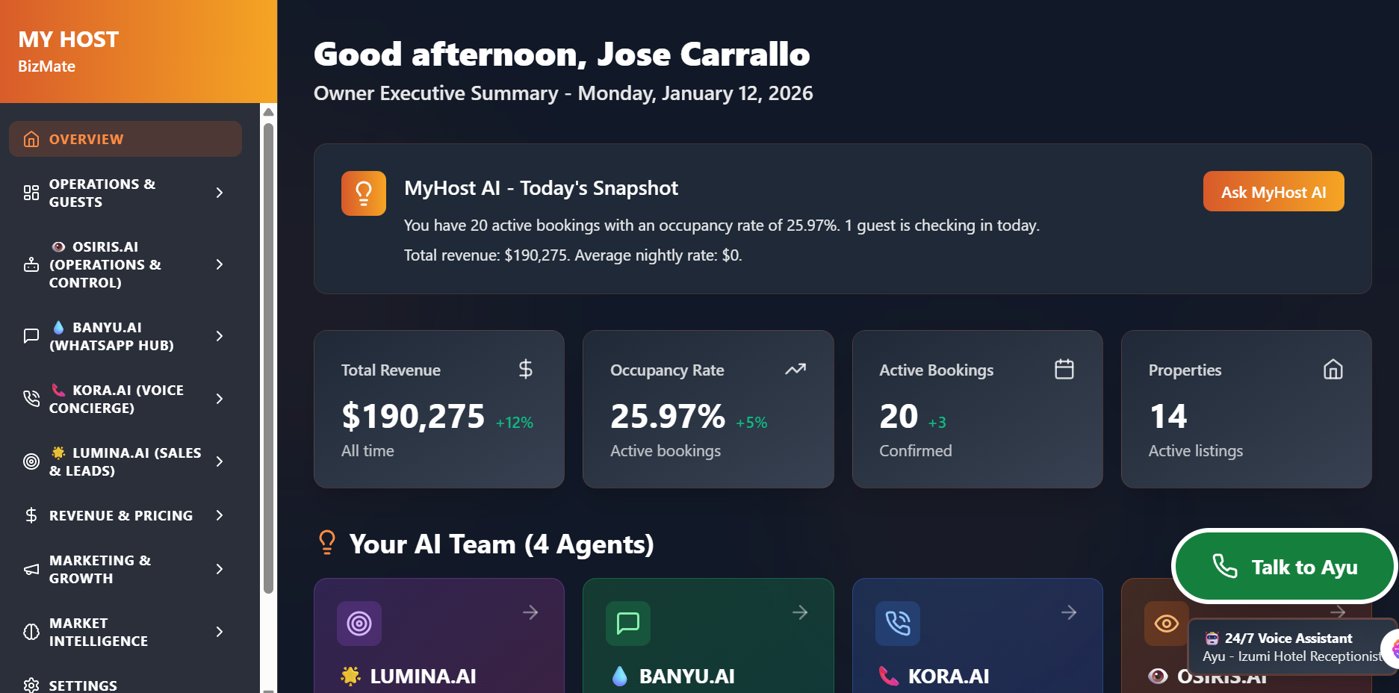

Slide 4


Platform Overview
MY HOST BizMate integrates advanced modules for effortless hotel management, inspired by Balinese luxury and efficiency.
LUMINA.AI
BANYU.AI
AI-powered sales and lead management engine.
WhatsApp guest assistant for seamless communication.
KORA.AI
OSIRIS.AI
Voice Concierge that answer guest calls,manage inquiries, AND SUPPORT BOOKINGS 24/7 when reception is not avaialbles .
Centralized control and operations management dashboard.
Support Modules
Guest Journey Automation
Website & Social Media Management
Owner Dashboard & Analytics

Slide 5






LUMINA.AI — Sales and Leads
LUMINA.AI is your intelligent system that transforms inquiries into confirmed bookings, optimizing every step of the sales funnel with Balinese inspired elegance and efficiency.
Lead Capture
Integration with Instagram, Facebook, Email, and WhatsApp.
Centralized Inbox
All communications in one place.
Sales Pipeline
Clear tracking of each lead.
Automated Follow-ups
Never miss a sales opportunity.
Confirmed Booking
Efficient lead conversion.
Key Features:
Central inbox
Sales pipeline
Automated follow-ups
Customizable message templates

Slide 6





BANYU.AI — WhatsApp Concierge
BANYU.AI is your 24/7 AI Guest Assistant working on WhatsApp, providing impeccable and personalized support.
Answers Guest Questions
Provides instant responses to frequently asked questions from guests.
Checks Availability
Verifies real-time availability for bookings and services.
Sends Confirmations and Reminders
Automates the delivery of booking confirmations and timely reminders.
WhatsApp Coexistence
Seamlessly integrates with your existing WhatsApp number, allowing both you and the AI to operate from the same contact.
Offer your guests a fluid and uninterrupted experience with instant responses to their needs.

Slide 7
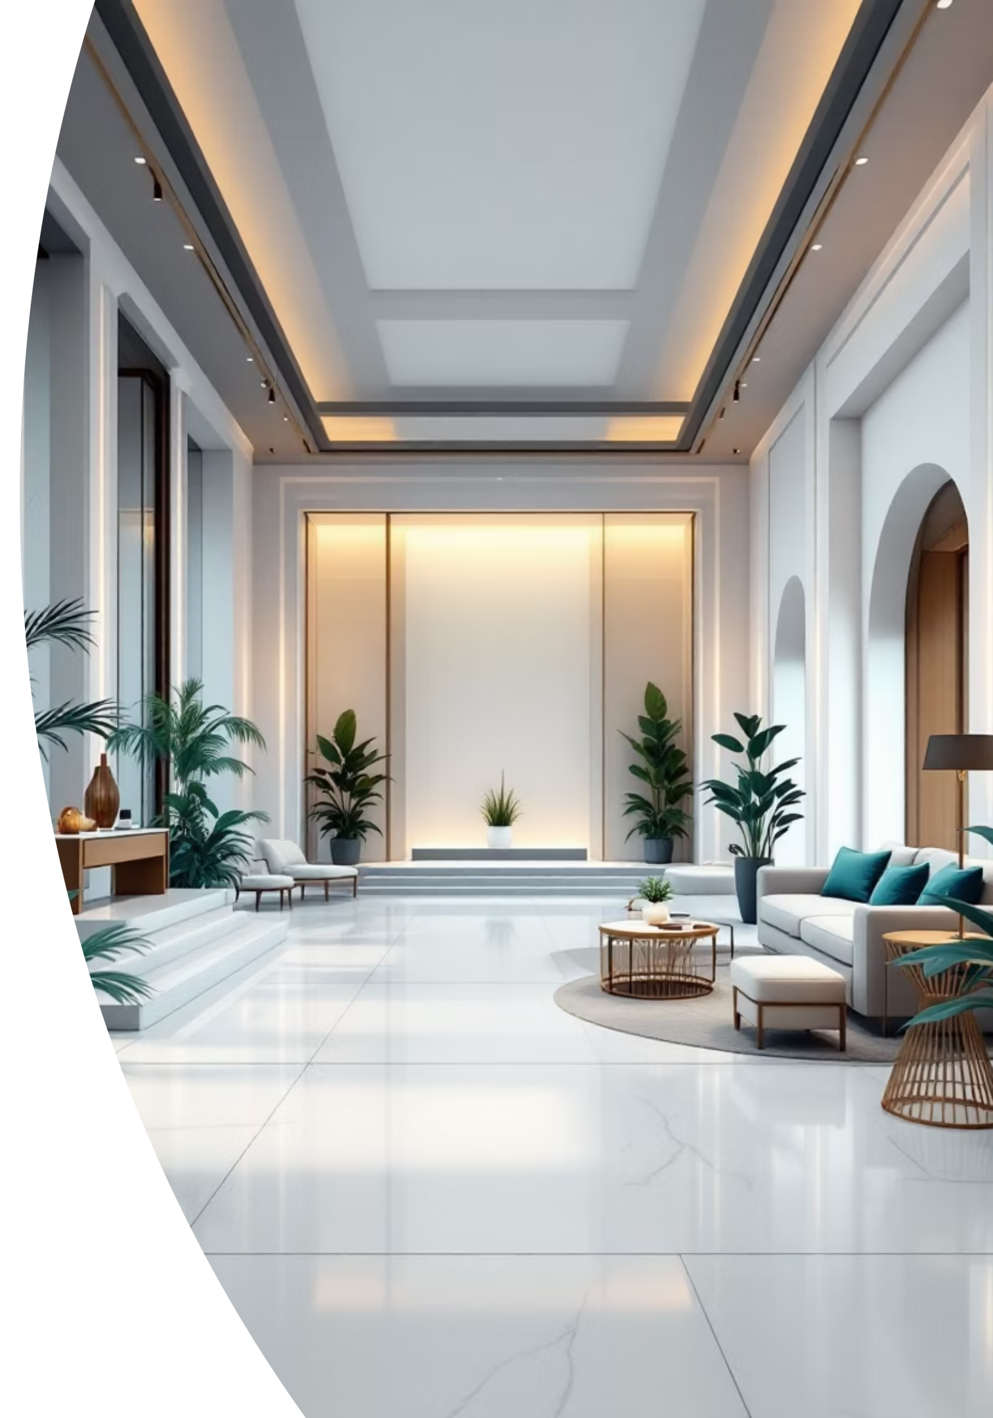



KORA.AI — Voice Assistant
AI that automatically answers your hotel's phone calls, ensuring no query goes unanswered.
Handles Calls When Reception is Closed
Manages calls outside of reception hours, ensuring continuous coverage.
Answers Booking & Availability Questions
Instantly provides information regarding bookings and real-time availability.
Uses Unified Data
Leverages the same consistent information as WhatsApp and the Control Panel.
Never miss a call again. Provide seamless, exceptional customer service around the clock, ensuring every guest query is answered.

Slide 8
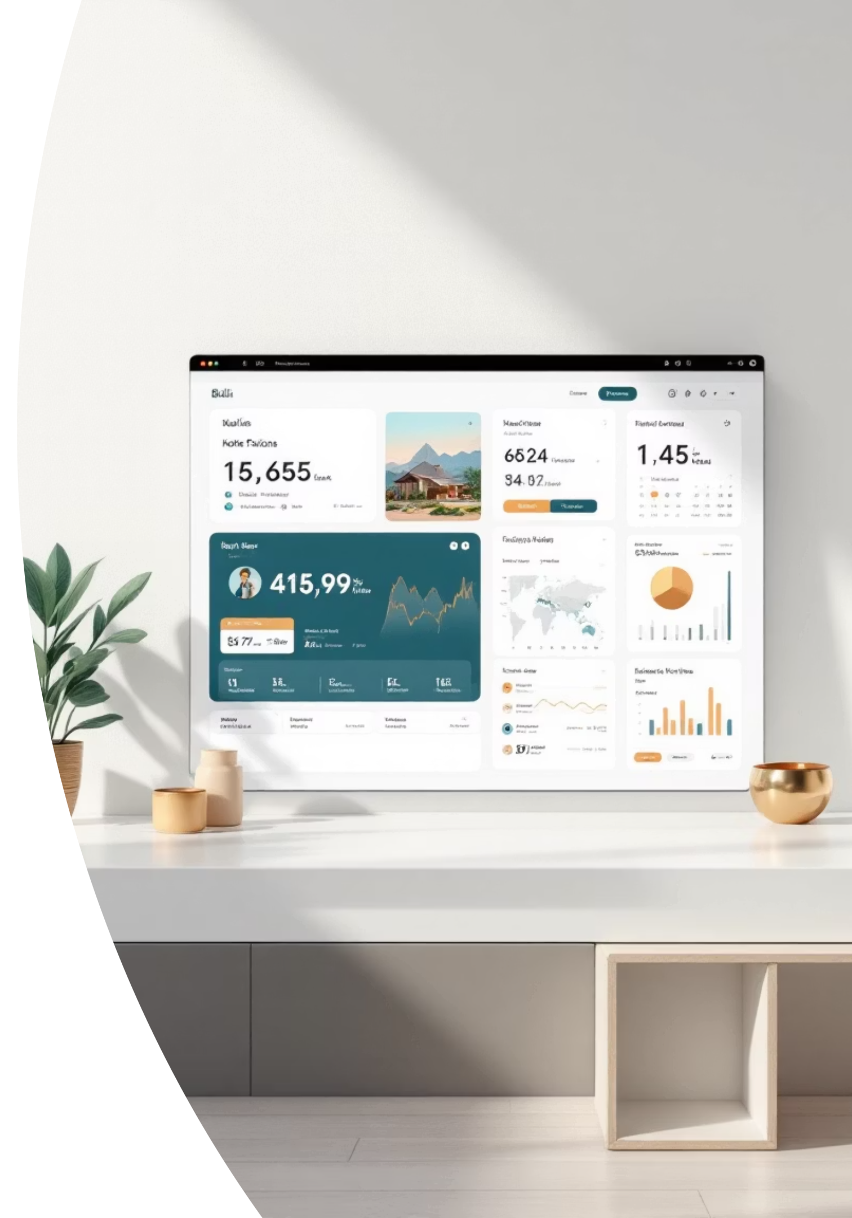
OSIRIS.AI — Operations and Control
AI system for owner operations and supervision, designed with a luxury Balinese aesthetic.
Bookings Overview
Comprehensive insights into all current and upcoming reservations.
Payments & Revenue
Real-time tracking of financial transactions and revenue generation.
Guest Status
Monitor guest movements and preferences for personalized service.
Alerts & Exceptions
Instant notifications for critical events requiring immediate attention.
The owner supervises. The system executes.

Slide 9
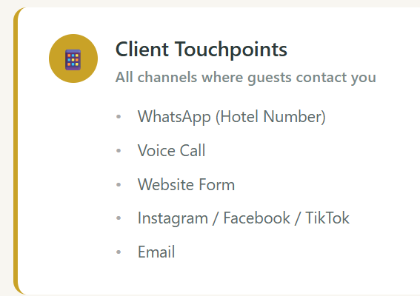
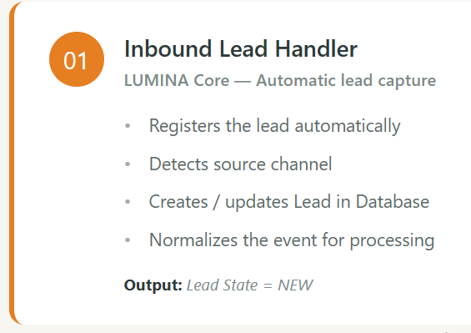
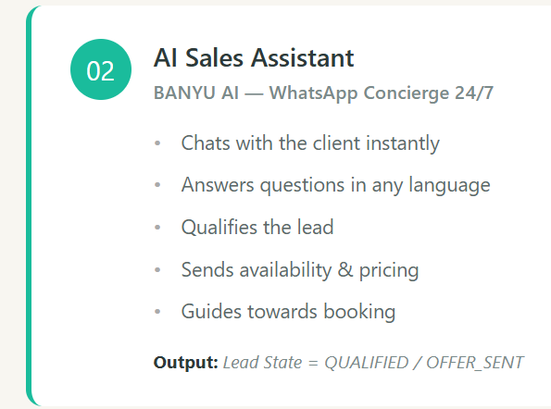
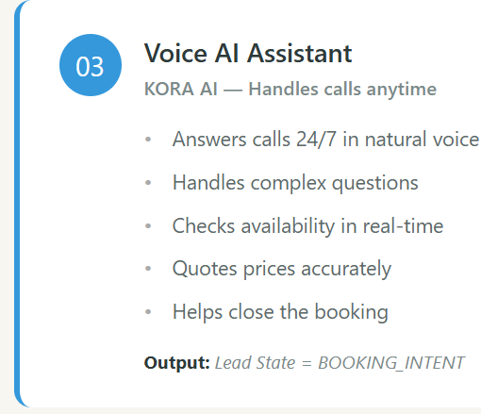

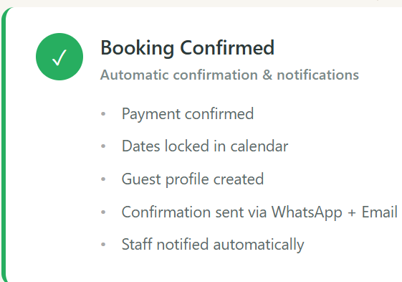
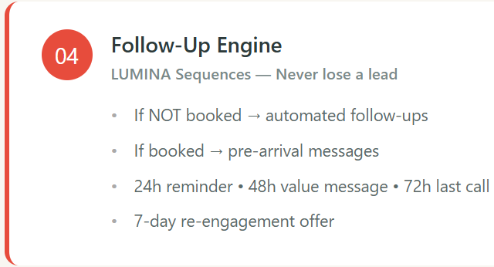
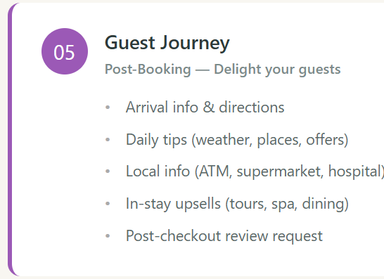
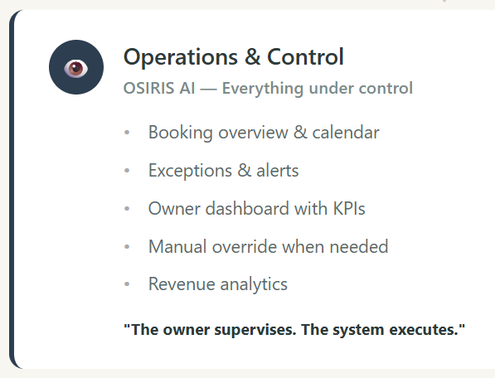

Slide 10



Guest Journey Automation
Accompany your guests at every stage of their journey, from booking to post-departure, with personalized and timely messages.
Before Arrival
During the Stay
After Departure
Ensure a smooth start with:
Enhance their experience with:
Foster lasting connections through:
Booking confirmation
Daily tips & greetings
Practical information
Weather & local info
Prompt follow-up messages
Upsell opportunities
Personalized recommendations
Encouraging reviews
Re-engagement campaigns

Slide 11

Website and Social Media
Elevate your digital footprint with our bespoke content generation and automation suite, tailored for your web presence and social media channels.
Sophisticated Website Presence
Dynamic Social Media Engagement
Intuitive booking platform
Automated content for Instagram, Facebook, TikTok
Seamless WhatsApp integration
Scheduled publishing and campaign management
Optimized for all devices
Automated guest content curation

Slide 12
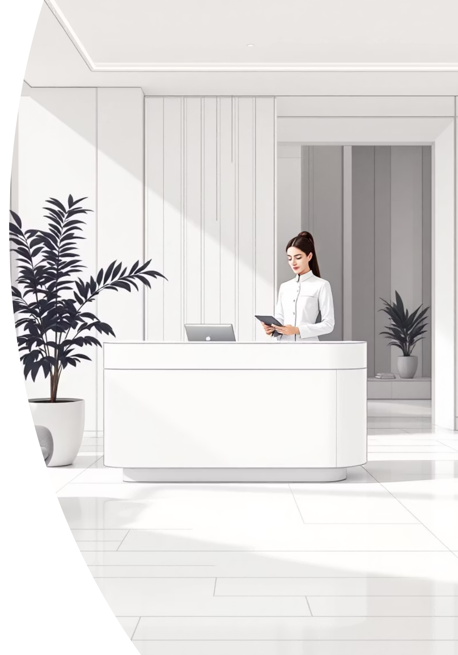





Real Use Case — Izumi Hotel
Discover how MY HOST BizMate transforms the management of Izumi Hotel, optimizing every aspect of its operations with Balinese elegance.
Leads Captured
Guests Answered
All inquiries are converted into potential reservations, automatically.
Continuous and personalized support 24/7 thanks to our AI.
Follow-ups Automated
Operations Controlled
Automate key communications to close sales without staff.
Complete visibility and management from a single platform.
Dashboard Overview
Centralized control for all your hotel operations.
One Platform. One System.
Real Automation.

Slide 13
MEETING GUIDELINE (VALIDATION)
OBJECTIVE Validate if MYHOST Bizmate workflows match the real daily reality of IZUMI Hotel
REALITY CHECK- What type of properties have you worked with?
What are the biggest daily headaches?
What tasks waste the most time?
Where do bookings get lost?
What happens when the owner is not available?
2) INBOUND LEADS (FLOW 01 – Inbound Lead Handler)
Where do leads come from today? (WhatsApp, Instagram, Booking, ..)
When someone writes on WhatsApp: - Who answers?
How fast? - What happens if no one answers?
Are leads tracked or lost?
Key idea: every message should automatically become a lead.
3) SALES PROCESS (FLOW 02 – AI Sales Assistant / LUMINIA)
What questions guests always ask before booking?
How many messages before clos`ing?
Do calls help close bookings?
When is a call useful vs annoying?
4) FOLLOW-UP (FLOW 03 – Follow-up Engine)
What happens when a guest stops replying?
Is follow-up done consistently?
How many bookings are lost because nobody follows up?
Key idea: most revenue is lost due to missing follow-up.
5) POST-BOOKING & STAY (Guest Journey)
What problems happen after booking?
What info would guests love to receive automatically? (weather, transport, supermarkets, ATMs, doctor)
What usually causes bad reviews?Key idea: proactive messages reduce problems and reviews.
6) OWNER VIEW (OSIRIS – Internal Agent)
What does the owner really want to see daily?
What problems need alerts?
What decisions could the system take automatically?
Key idea: owner wants alerts and exceptions, not dashboards.
7) FINAL QUESTIONS- Would you personally use this?
Would you pay for it?
What would you remove?
What is missing to make it essential?
CLOSING QUESTION“If this system did automatically what you do manually today,would it make sense for you as an owner?”
Would you pay for it?

